Slide 1
Ecocriticism and Literature
What is the relationship between ECOcritical analysis and creative writing?
Richard Kerridge
Nature Writer and Ecocritic
Course Director, MA in Creative Writing, Bath Spa University
Founding Chair, ASLE-UK and Ireland
This lecture is supported by the Santander Pioneer Scheme.

Slide 2
In this lecture I will draw upon my different areas of academic experience and attempt to bring them together, or at least explore the challenges they make to each other. There are three areas.
1. I am a creative writer. My genre is nature writing, which combines literary description of the natural world with scientific natural history and ecology, philosophical argument, cultural analysis and personal memoir. My book Cold Blood is a lyrical and scientific treatment of the British reptiles and amphibians, and also a coming-of-age story and bereavement memoir. This is the genre of writing that many ‘first wave’ ecocritics sought to install in the literary canon, since they saw it as a genre that might play a valuable part in transforming public attitudes. Since then, however, ecritics from the ‘second wave’ have questioned the genre, asking whether it can be separated from its historical associations with white masculine colonial narratives of exploration, or with conservative rejection of urban democratic modernity. An important question for me, and for many contemporary British nature writers, is whether the genre can be pulled free of these traditions. If so, the hope is that the genre can foster a popular love of wild nature that is ecologically informed, responsive to environmental threats, diverse in its points of view and interested in dialogue between different perspectives.

Slide 3
2. I am an ecocritic. I want to evaluate literary texts and other cultural forms on the basis of whether they are helpful or harmful to our collective efforts to avert environmental crisis? Do they perpetuate attitudes that might once have been valid but that now have to change, such as the representation of wild nature as a relatively unchanging set of conditions, in contrast to the dramatic changes of fortune faced by human individuals or groups? Can the traditional literary and artistic forms be used to represent our current crisis, or do we need new forms and genres?
Ecocriticism is often perceived, like other cultural and political movements, as having transformed itself in a series of waves. This metaphor is not entirely satisfactory, since it suggests that each new wave has displaced the last, in a simple succession. What in fact happens is that new waves arrive and become central and powerful, but the earlier waves do not disappear. They are not exhausted or obliterated. In ecocriticism the first and second waves are still advancing, even though the third has arrived – and there are many small sub-currents that may grow into new waves or persist as smaller forces.

Slide 4
Ecocriticism’s waves
First wave
Among the first scholars to call themselves ecocritics, in the early 1990s, there was frequently a determination to counteract what they saw as the excessive abstraction and cultural constructionism of the post-structuralist theory that was then so dominant in literary and cultural studies. This view is well represented in The Ecocriticism Reader, edited by Cheryll Glotfelty and Harold Fromm (1996). These critics believed that the emphasis on cultural construction – which usually meant sceptical deconstruction – had led to a dangerous neglect of the study of physical reality. Their answer – exemplified by Jonathan Bate’s insistence in Romantic Ecology (1991) that the owls in a poem by William Wordsworth must be taken seriously as real owls, and that metaphorical meanings should not displace their reality – was to return to a realist and at least partly literalist account of linguistic representation.
With this went a determination to revise the literary canon by including, and taking seriously, the nature writing genre, previously seen as naively literalist or escapist.

Slide 5
Second wave
A further and much wider extension to the literary and cultural canon was demanded in the late 1990s and early 2000s by what in the USA is called the Environmental Justice Movement. These were ecocritics concerned to reveal the connections between environmental problems and the forms of social injustice inflicted on women, people of colour and working-class people, or rural poor people, or indigenous people who were victims of colonialism. The project of this second wave was to pay intersectional attention to the ways in which different victimised groups were disproportionately exposed to environmental hazards. Second wave ecocriticism explores the relationships between environmental priorities and those of feminism, anti-racism, queer theory, postcolonialism and the continuing struggle decolonization. From these perspectives, nature writing and other traditions of the love of wild nature would be interrogated as to whether they were exclusively white, masculine, or western.

Slide 6
This statement by Lawrence Buell describes the shift:
…early ecocriticism’s enthusiasm for restoring contact between modern humans and the natural world. . .has to a large extent given way to indictment of preservationism as an imposition of the privileged (white, affluent, Eurocentric) and of the conception of the ‘natural world’ itself qua space apart as a specious artifact of cultural nostalgia.
Lawrence Buell, Preface to LeMenager, Shewry and Hiltner, eds, Environmental Criticism for the Twenty-First Century (2011).
Other influential examples include Rob Nixon’s concept of ‘slow violence’ (the environmental and social violence inflicted on far away countries by Western habits and structures of consumption but is stubbornly invisible to those consumers) and Val Plumwood’s concept of ‘shadow places’, the invisible, haunting partner-places of rich Western localities. Their shadow places are the ones where apparently innocent consumerism does damage that the consumers do not see. Ecocriticism has another important job here: to point to the invisibility in the West of the ‘slow violence’ that results from our myriad small acts of consumerism, and to imagine and encourage forms of representation that would make these connections visible.

Slide 7
Third wave
This is Posthumanist, New Materialist and Anthropocene Ecocriticism:
…‘its intellectual project is a redescription of the world that dissolves the singular figure of the human subject, distinguished by unique properties (soul, reason, mind, free will or intentionality), into the dense web of material relations in which all things are enmeshed.’
Hannes Bergthaller, ‘Limits of Agency’, in Serenella Iovino and Serpil Opperman, eds, Material Ecocriticism (2014), 37
Third wave ecocriticism seeks to change the pervasive emphasis in Western culture upon the distinctness and autonomy of the individual self. Selfhood is not denied, but its embeddedness in material networks and systems, by which it is constituted and maintained, is given greater emphasis. In a curious way, this move brings ecocriticism back into compatibility with post-structuralism, with its emphasis on continuous construction and discursiveness – but the ecocritical version is material as well as cultural, and the two forms of construction are inseparable.

Slide 8
What is advocated is a shift of emphasis in the way we imagine the self, from the self as an atomised individual with hard-boundaries to a self always already in the process of producing the world and being produced by it; a self through which the world flows; a self that is as conceptually inseparable as it is materially inseparable from the larger ecosystem that sustains its physical body. Ecological perception dissolves unifying notions of selfhood and strong dualistic separations between culture and nature, subject and object or human and nonhuman. Instead of these hard selves and boundaries, we have shared ancestry, co-evolution, system, process, energy flow, hybridity, actor-networks, post-humanism, symbiosis, biosemiotics and the continuous mutual constitution of self and world: the system of relationships that Timothy Morton calls ‘the mesh’ and New Materialist theorists call ‘distributed agency’. For Morton, this idea – the ‘ecological thought’, as he calls it – is an opportunity to reconcile ecocriticism with post-structuralist theory, by discovering that in the material world as well as the cultural, there is nothing that is pre-discursive or non-discursive.

Slide 9
I now come back to my third academic practice. I am a teacher of creative writing, as well as literary criticism. We mainly teach using the workshop method. The workshop groups consist of not more than eight students; the context groups eight to ten. Each week four students circulate work by email, in advance of the class. These pieces are not more than ten pages of prose or poetry. Everyone reads them and comes to the class with notes and prepared comments. Students are asked to identify the strengths of the writing and the areas that need improvement, and to make some comments about local matters such as particular words, sentences and paragraphs, and some about the forward-reaching strategies of the work, if it is an excerpt from a whole book in progress, or about the overall decisions the author has made if it is a single complete piece such as a short story. Sometimes we go round the room, giving comments in turn, and sometimes have a more spontaneous discussion in which students join in as points occur to them. Either way, the usual convention is that the author of the piece remains silent during this phase, and listens without debating the points made. After this phase, the author has the opportunity to comment on what has been said, and then the tutor gives their own thorough response to the piece, followed by one more phase of open discussion.

Slide 10
So, my question is how can I bring these three practices together. How can I write my nature writing in a way that is responsive to the aims and concerns of all three ‘waves’ of ecocriticism? And how can my teaching – my workshopping of novels, stories, poems and non-fiction written by students – be similarly responsive? The influence, of course, should not go entirely one way. It is also important to ask how the critical practice, the ecocriticism, in all three varieties, can be changed by the lessons learned in creative practice. New Materialism has an unfortunate paradox. Its emphasis is on materiality and process. All life, all action, is embedded in ecological relations, processes of constant semiotic and evolutionary exchange. It is always already discursive, always already engaged in a network of what the physicist and ecocritic Karen Barad calls intra-action (her term is an alternative to ‘inter-action’, which implies relations between two already formed entities rather than the ceaseless mutual constitution of all entities that she wants to describe). There is no position outside or prior to this embeddedness. This is what ecocriticism has taken from post-structuralism and Heidegger. Yet the paradox is that this idea exists primarily, at present, in the form of abstract theory. How can it become a creative practice, a literary form or style. This is a question for the ‘new nature writing’ – the startling resurgence of the nature writing genre that has occurred in the UK over the last decade or so.

Slide 11
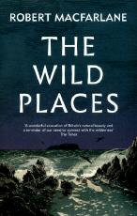
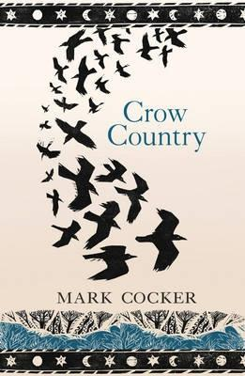
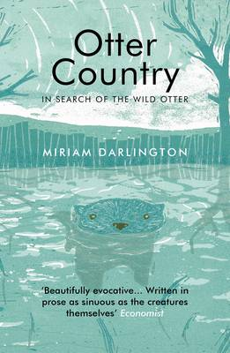
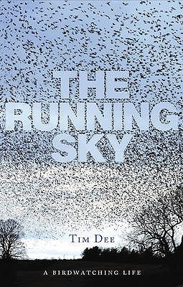
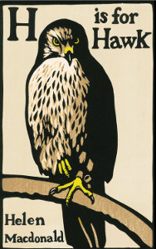
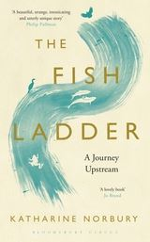
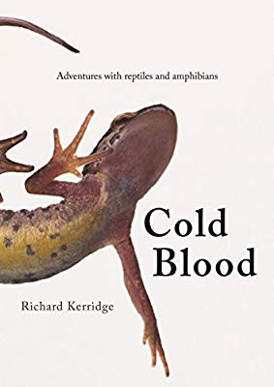
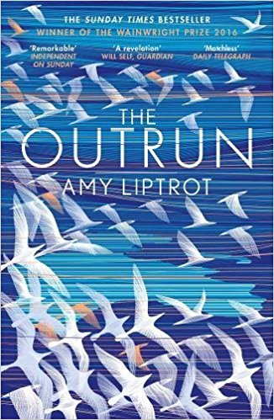
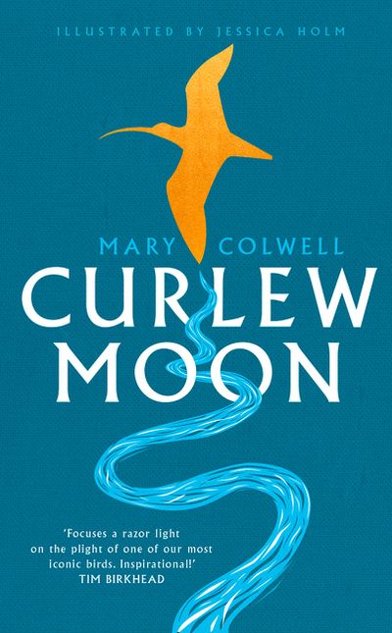
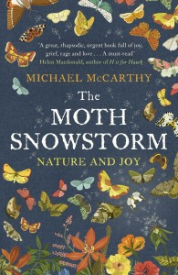
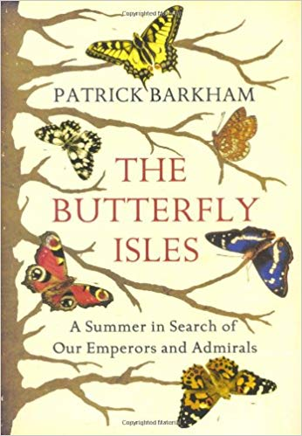
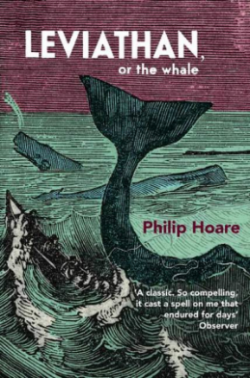
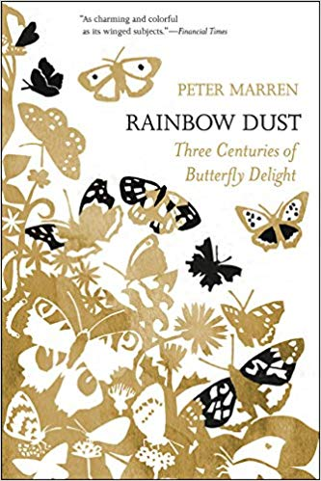
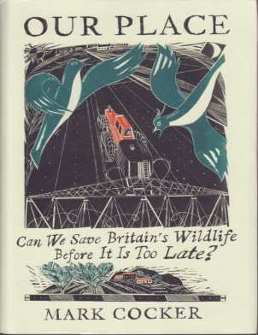
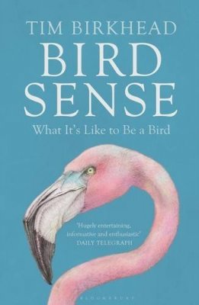
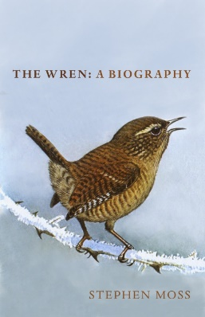
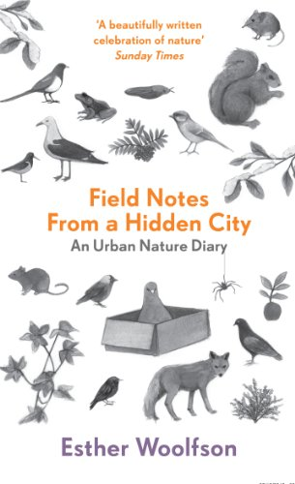
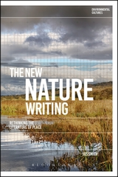

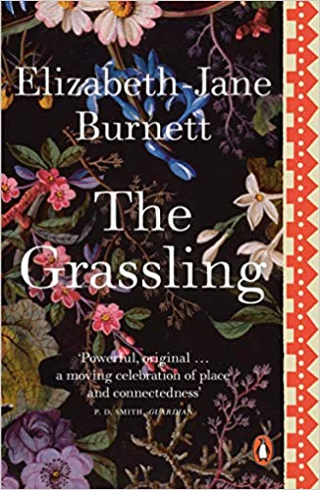
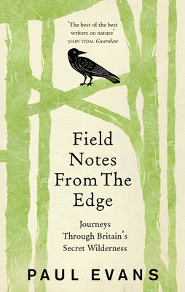
The New Nature Writing?

Slide 12
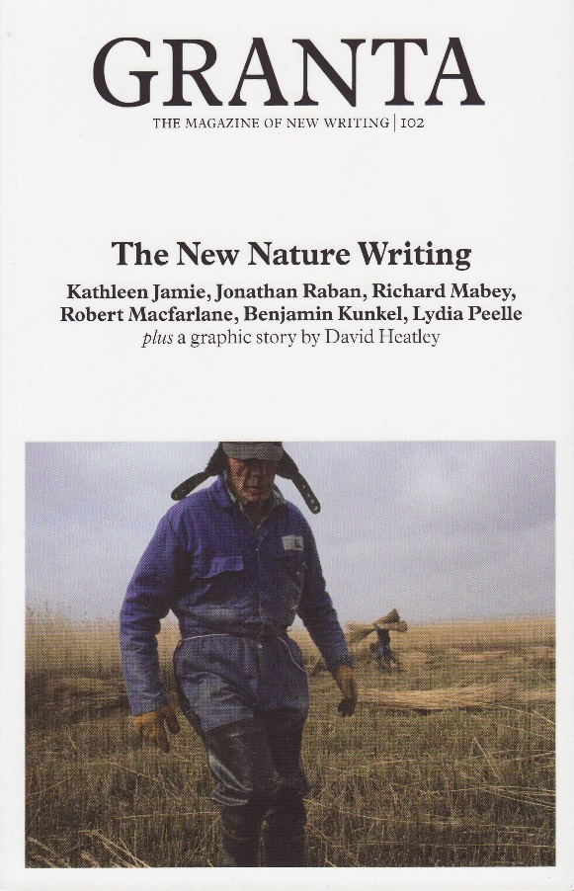
Title after title has appeared, and some – pre-eminently H is for Hawk, Helen Macdonald’s combination of nature-writing and bereavement memoir – have achieved mass readership. A literary agent said to me recently that he thought publishers at the moment were looking for two kinds of book: psychological thrillers and nature writing. Certainly this development is a source of hope for environmentalists and ecocritics. Why has it happened? Why has this genre suddenly re-emerged so strongly? Could it be connected with growing public unease about climate change and biodiversity loss? If so, we could be seeing a sign of a major cultural shift with the potential to become a political shift also – though it feels risky to extrapolate too much from a literary development.
But how new is this ‘new nature writing’? What would it have to do to be new in ways ecocritics would find valuable. Perhaps it is easiest to define these qualities by looking at the tendencies of the ‘old nature writing’ that ecocritics find problematical – the tendencies that the new writing should try to recognise and change.

Slide 13
The old nature writing
• expressed a defensive anti-urban and anti-cosmopolitan (and thus anti-ecological) desire for solitude
• rejected mass-democratic industrial modernity and sought enclaves that offered escape
• featured protagonists who turned away from social life and sought epiphanies in solitary encounters with wild nature (though there was always a paradoxical quality to that desire when it was disseminated in popular literature)
• frequently found itself in a conservative stance, because industrial development threatens wildlife, and most wild species are much less abundant than in the pre-industrial past. The genre thus became associated with searches for a mythical past

Slide 14
These are the challenges I put to nature writers, including novelists and poets, in the writing workshops, along with the aims of the three ecocritical ‘waves’. There is one more to add. The ecocritic Timothy Clark, in his Cambridge Introduction to Literature and the Environment (2011) and his later book Ecocriticism at the Edge (2015), sees what he calls ‘derangements of scale’ as the central difficulty posed by climate change and other ecological problems. For Clark, a powerful reason why we find these problems so difficult to act upon, and why literature and the other arts find them so difficult to represent, is that they play havoc with our accustomed sense of scale – our perception, especially, of which actions and events are important and which are trivial. is new world as stranger than even most ecocritics have realised. Disconcerting adjustments must be made to our recognition of which actions and topics are important and which trivial:
Environmental slogans urge us ‘eat less meat and help save the planet’, or they follow horrifying predictions of climate chaos with injunctions, no less solemn, not to leave electrical appliances on standby or overfill the kettle. Such language would have seemed surreal or absurd to an earlier generation and enacts a bizarre derangement of scales, collapsing the trivial and the catastrophic into each other. (CILE, 136)

Slide 15
Startling transformations of literary orientation and form are required. Can we imagine stories concerned not only with characters falling in love or facing immediate physical danger but also with how those characters learned to change in response to ecological crisis?
Is it imaginable, a novel in which a character’s failure to switch off the lights was treated as a momentous tragic error and used as a dramatic plot-point like a falling-in-love or a murder? The particular character’s failure would have to represent the general failure of consumer society. That character would have to be given epic status in some way.
Or do we need to move further away from conventional ‘stories’ and ‘characters’? For Clark, ‘character’ is part of the problem, since conventional fictional ‘character’ makes the personal lifespan into the main timeframe of the fiction. Implicitly or explicitly, the usual suggestion is that the dramatic intensity of the novel’s plot derives from the reader’s perception that its plot-points, its most intense moments of action, are the decisive events of the characters’ lives: the ones that most determine the emotional tone of the remainder of those lives after the plot’s conclusion (‘they lived happily ever after’). But ecological problems often need to be projected onto longer periods of time than the individual lifespan.

Slide 16
Climate change gives us the clearest example of this need. To perceive climate change, we need to look back into deep history, using a variety of sources of evidence, and forward into at least the next hundred years, using a variety of ways of making projections:
As a result of scale effects, what is self-evident or rational at one scale may well be destructive or unjust at another. Hence, progressive arguments designed to affirm individual rights and help disseminate Western levels of prosperity may even resemble,on another scale, an insane plan to destroy the biosphere. Yet, for, say, any individual household or motorist a scale effect in their actions is invisible. It is not present in any phenomenon in itself, but only in the contingency of how many other such phenomena there are, have been and will be, at even large distances in space or time. Can the Leviathan of humanity en masse, as a geological force, be represented? No, at least not in the realist mode still dominant in the novel. Its effects are global and non-localizable. (EE, 73)

Slide 17
Much of the controversy about climate change has focused on these timeframes and the methods involved in constructing these projections, while much of the ethical debate has been concerned with the definition of responsibilities to future generations. These timeframes are difficult for ‘character’-based narrative to encompass.
Similar difficulties are raised by the long-distance nature of many of the ecological relationships implicated in the environmental crisis, and also by the relationship Clark mentions between very small, conventionally trivial actions and immense consequences, a relationship that obscures the scale on which moral consciousness and narrative normally operate. Climate change manifests itself in ways that are too small and too large, too close and too distant. The middle distance is missing. Lyric poetry that uses an ‘I’ persona also has difficulty with these perspectives, having to bring them within the frame of a dramatized personal consciousness.

Slide 18
These formal literary difficulties are instructive, revealing some reasons for the impasse between our awareness of climate change and our inability to act on that awareness. Along with the moral precision required by the uncertainty but probability of climate change, these almost inhuman perspectives are very challenging. The struggle to bring them into a personal outlook, and into the drama of individual lives, is an exemplary struggle. Literary strategies are available, though not yet well developed. Clark is interested in those strategies, but his main focus is on the literary problem as a manifestation of a much larger cultural, philosophical and political problem: a crisis for liberal individualism. Environmental threats necessitate a change, of emphasis, at least, from ‘the foundational assumption of liberal thought’ – the assumption that ‘a human being is an essentially private, atomistic and apolitical individual’ (CILE, 103).
Part of the argument is familiar. The liberal version of selfhood emerged as consumer society emerged; a society whose ethical and cultural norms rest on the assumption that endless economic growth is desirable and possible. Indispensable to the legitimation of that society is the prospect of growth that in time can bring the mass of the world’s population up to the material standard of living of the Western middle class, while continuing to raise that standard further. Without that promise, the huge inequalities of wealth in the West and across the world would demand other remedies.

Slide 19
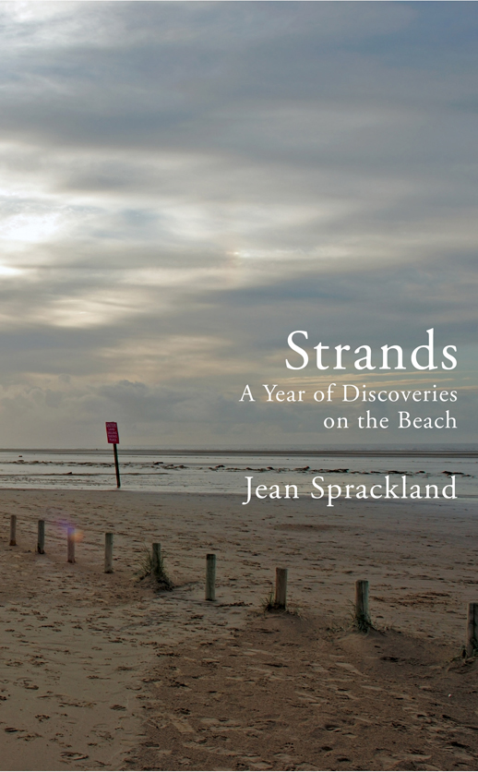
These formal literary difficulties are instructive, revealing some reasons for the impasse between our awareness of climate change and our inability to act on that awareness. Along with the moral precision required by the uncertainty but probability of climate change, these almost inhuman perspectives are very challenging. The struggle to bring them into a personal outlook, and into the drama of individual lives, is an exemplary struggle. Literary strategies are available, though not yet well developed. Clark is interested in those strategies, but his main focus is on the literary problem as a manifestation of a much larger cultural, philosophical and political problem: a crisis for liberal individualism. Environmental threats necessitate a change, of emphasis, at least, from ‘the foundational assumption of liberal thought’ – the assumption that ‘a human being is an essentially private, atomistic and apolitical individual’ (p. 103).
However, there are literary solutions that combine a conventional narrator-protagonist with some of the abrupt and extreme shifts of scale Clark demands. One is to be found in Strands (2012) by Jean Sprackland, a book about her regular walks on Ainsdale beach near Liverpool. As a setting, the beach immediately brings together contrasting scales of experience, since it is at one a sublime threshold – an edge from which the infinite may be confronted – and a comforting and familiar leisure-space. Each chapter is built around a particular object encountered on one of the walks – a deep-sea creature washed up at her feet, an industrial relic, a wild animal, or, in one chapter, a mass of discarded plastic objects. She makes a list of these:

Slide 20
Petrol can-1
Drinks carton–2
Sanitary towel wrapper–13
Sweet wrapper–39
Chocolate bar wrapper–49
Toy dinosaur–1
Rope–2
Crisp packet–4
Bart Simpson stencil–1
Ice-lolly wrapper–7
(Strands, 111-112)
Can we even imagine a world without plastic? What was life like before it so thoroughly colonised our homes, offices, vehicles, streets, shops, gardens and parks? Its success story has been so phenomenal that it’s hard to say what we would be without it. But our grandparents would know. We’ve only been mass-producing plastic since the 1930s: there was a time within living memory when plastic was a rare sight, and a novelty. (Strands, 107)

Slide 21
Several of Clark’s scale derangements are here. There is the fact that the mass-production of plastic goods began within living memory. Set against geological time, or ‘deep time’, that is a minute period, scarcely an eye-blink. But in that time the plastic has filled up the world, becoming one of the main pieces of evidence that human activity is now a geological forcing agent, which is the basis of the concept of the Anthropocene. Spatially, the chapter moves from the immediate setting and unthreatening scale setting of the beach, contained by an afternoon walk, out to the immensity of the Great Pacific Garbage Patch.
As with the washed-up deep-sea creatures, there is a curious inversion in which the deepest and most inaccessible places become thoroughly known and domesticated, while the nearby, familiar places become mysterious and vast in their connections. One is reminded of the tin of spam at the bottom of the Mariana trench.

Slide 22
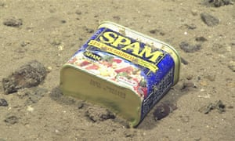

Slide 23
In Sprackland’s list, the ordinary domestic objects, especially the children’s toys, have an innocence about them. They are too trivial to matter. But they are destroying the world. The toy dinosaur presents several ironies, giving us deep time and trivial domesticity at once, and combining also the cuddly and the threatening.
A similar effect occurs when Sprackland comes across human and animal footprints exposed as the retreating tide has peeled off a layer of mud. They are prints from the late Mesolithic period – roughly from the year 7000 BC, when Neolithic culture was first emerging in Europe. When the tide comes in again, they will be washed away. Preserved in darkness for thousands of years, in the light they will last only hours.
Perhaps, however, a more problematical scale-contradiction in Sprackland is in the way that however vast the spaces and time-periods each chapter opens, all are contained in the short leisure activity, the afternoon walk. At the end she goes home, or goes back to work, and the huge scales she has opened close once again. They are contained in that space.

Slide 24
I should conclude with something of my own. This passage from Cold Blood, about anthropomorphism and the Common Toad, tries to combine reflection with anecdote, each containing the other:
That is the puzzle of anthropomorphism. We need it and we need to overcome it. A dolphin’s face seems to wear a friendly smile. We know that this smile is not really a smile, but a shape of face and mouth that evolved for other reasons. The line of the mouth does not really mean that the dolphin is friendly. We need to acknowledge this. But the idea of suppressing our recognition of the mouth-line as a smile, to the point of banishing that recognition altogether, seems a violent idea to me. The recognition is rooted in our earliest learning of how to make sense of the world, how to live there. We need to see the dolphin’s expression as a smile and to know that it is not.
One of the cultural functions of wild animals for human beings has always been to provide archetypes of different sorts of moral character – the cunning predator, the foolish predator, the worker, the idler, the boaster, the self-sacrificing mother. Such figures make up an allegorical landscape of clear moral categories. They are landmarks in the distance that tell us where we are. If that moral landscape is not continuous with the real, material landscape in which we live, we are estranged from that real landscape: not really engaged with it, but living in a separate mental world.

Slide 25
With wild animals there is, traditionally, a licence to use stereotypes, since the animals have no power over us, and we are not wondering whether they will become our personal friends or enemies. I interpret the toad’s face – its generic features more than those of any particular toad – in anthropomorphic ways because I have only a weak sense that toads have individual personalities.
How, then, are we to respond to animals in human terms – emotional and imaginative terms, as well as scientific terms - while also seeing how different from us they are? Anthropomorphism has its dangers, of course; not least to the animals themselves. I find toads likeable, but there is a long tradition of associating them with evil. Witches were believed to keep them as familiars. Sometimes toads were the Devil in disguise. He appeared in toad form to be kissed on the lips by the witches. Toads had a Gothic, gargoyle-like quality. To the popular medieval mind, the world was teeming with small demonic beings, peering maliciously from the undergrowth. The migrations of toads through the fields must have seemed like the movements of goblin armies.

Slide 26
Thomas Pennant, the eighteenth-century naturalist, described the toad as “The most deformed and hideous of all animals; the body broad, the back flat, and covered with a pimply dusky hide; the belly large, swagging, and swelling out; the legs short; and its pace laboured and crawling; its retreat gloomy and filthy; in short, its general appearance is such as to strike one with disgust and horror.” Pennant was rebuked for these words by Thomas Bell, whose wonderful History of British Reptiles, published in 1839, is the first natural history book about these creatures. But Bell himself, determined to find in all wild creatures the evidence of a beneficent Creation, can only call the Common Toad “far from prepossessing”. “The body,” he says, “is puffed out and swollen; the head large, flat on the top; the muzzle rounded, and very obtuse. There are no teeth either in the jaw bones or on the palate. There is above the eyes a slight protuberance, studded with pores’ and the parotids” – these are the poison-glands behind the eyes – “are large, thick, prominent, and porous, secreting an acrid fluid.” Bell is attempting to be scientifically dispassionate, but words like “dirty” keep turning up in his description. He says that the toad’s “upper parts are of a dirty, lurid, or blackish grey, with sometimes a slight greenish tinge; tubercles” – these are the warts – “more or less brown; beneath dirty yellowish white, sometimes spotted with black.”

Slide 27
Shakespeare’s Othello, deceived into suspecting that his wife Desdemona has taken a lover, feels that his centre, the shyest part of him, his most sacred emotional place, has been defiled. An intruder has dirtied it.
But there, where I have garner'd up my heart,
Where either I must live, or bear no life;
The fountain from the which my current runs,
Or else dries up; to be discarded thence!
Or keep it as a cistern for foul toads
To knot and gender in!
When I first read these lines at school, I laughed aloud. I knew those foul toads. They mattered to me. I saw the image; I knew what this ‘knot’ was. Male toads congregate in the ponds in Spring, squeaking rapidly, heads just above water. Each is desperate to fix himself to a female’s back. Hormones are surging, pheromones tugging. Five or six males, squeaking in crescendo, converge on a female, grabbing at her from all sides. If a male is already on her, they try to force their heads in under him, to prise him off. He kicks at them, and tries to steer the female away, but three or four rival males have already taken hold. The female is overweighted now, and the knot of toads rolls over like a ball.

Slide 28
More males arrive, as many as ten, clasping on where they can, arching their backs and squeezing tighter. They grapple and strain. The water boils with their struggle. She is buried at the centre. Often she drowns. They squeeze the breath out of her, and stop her from surfacing for air. Males in these frenzies grab anything. Sometimes frogs are pulled in, even fish.
Once I tried to save the female. I was in my thirties, teaching at a school in South London, and had taken a small group of students, five or six of them, aged fourteen or fifteen, for a natural history ramble on a common that was popular with dog-walkers: a bit of gorsey heath, a bit of woodland and a golf course. Walks like this were one of the things we did on the afternoon reserved each week for General Studies. There was a pond at the bottom of a grassy crater, and we scrambled and slid down the bank to see what life there might be among the brown reeds. Immediately I heard male toads squeaking, and pointed out a small group of them, sitting on the pondweed. My students, hugging themselves in their coats, seemed unimpressed.
“I’ve got mud on my trainers,” said one. “And my tights! Aow. My mum’ll kill me, sir.”
“What’s that over there?” said another.
To one side of the pond, in deep water and dark weed, with the sandy bottom looking slightly bluish, was a rolling ball of toads.

Slide 29
“What are they doing?”
“Yeah, what are they doing, sir?” That was one of the boys.
I explained. A burst of squeaking came from the toads, and the ball rolled towards us.
“Oh God, sir. Can’t we do something?”
“I think you ought to make them stop, sir.”
“Yeah, sir.”
“All right.” I grinned nervously. “All right. I’ll try.”
Leaning out across the pond, I used a stick to manoeuvre the ball towards me. It bobbed in the water. My hands were shocked by the cold, but I got them under the ball, and felt the softness of the struggling bodies. In response to my touch, the toads bound themselves tighter. I lifted the whole writhing mass from the water, and tumbled it onto the grass, in a tumult of squeaking. The ball had many voices. I expected it to come apart out of the water, but none of the males would let go.
My students had all gathered round.
“God. Look at them.”
A greenish male was on top of the ball, his glistening skin quivering. In his yellow-gold eye, the black pupil had flattened into a line. It made him look sexually drowsy. His squeaks sounded tired and tinny, but went on. I tried to get my finger under his gripping arm, to break the tension of his hold, but his arm was quite rigid. He gripped harder, his eyes disappearing under his cheeks with the effort. I was afraid of snapping his arm.

Slide 30
“What are you doing?” At the top of the bank, a woman looked down at us. She looked about forty, and was wearing a long scarf. Crinkly blonde hair. Beside her a big dog, a lurcher, pulled at the lead. “I don’t believe it”, she said. “You’re trying to stop them. Leave them alone. It’s natural.”
“No,” I said, “No. I’m trying to save the female. There are too many males on her. They could drown her.”
“Really?” she said, suspiciously. “Are you sure?”
“I’ve seen it happen.”
“It’s true,” piped up one of the students.
“Oh,” she said. “Well - oh. Can you get them off her?”
“I don’t think I can. They are gripping too tightly. I’m afraid of hurting them.”
“Better put them back, then,” she said firmly. She was right. I picked up the ball again. In my hands it struggled like a single creature. The students watched in silence. A toad’s leg forced its way between my fingers. At least the female had probably taken some breaths. If I left the ball out of the water, crows would probably attack it. I placed it back into the pond.

